Slide 1

T1A2 – Portfolio Slide Deck
Edward Dougherty

Slide 2
Overview
Portfolio website and its features
Design process and decisions
Review of development/build process
with challenges, ethical issues, favourite parts.

Slide 3
Designing Process
Sitemap
Website inspiration
Colour palette decision and contrast checker
Font pairing
Figma design
Changes to the original design

Slide 4
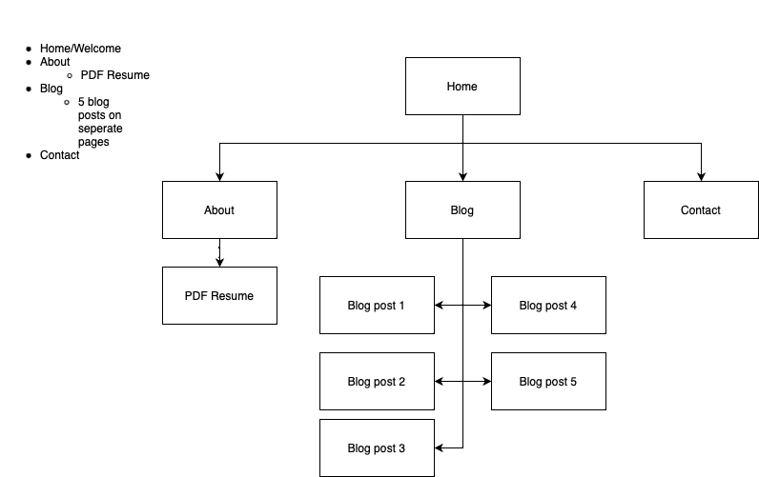
Sitemap
The overall flow of the site is feels natural.
With 4 main pages and 5 sub blog pages it was quite easy to see where the site was going.

Slide 5
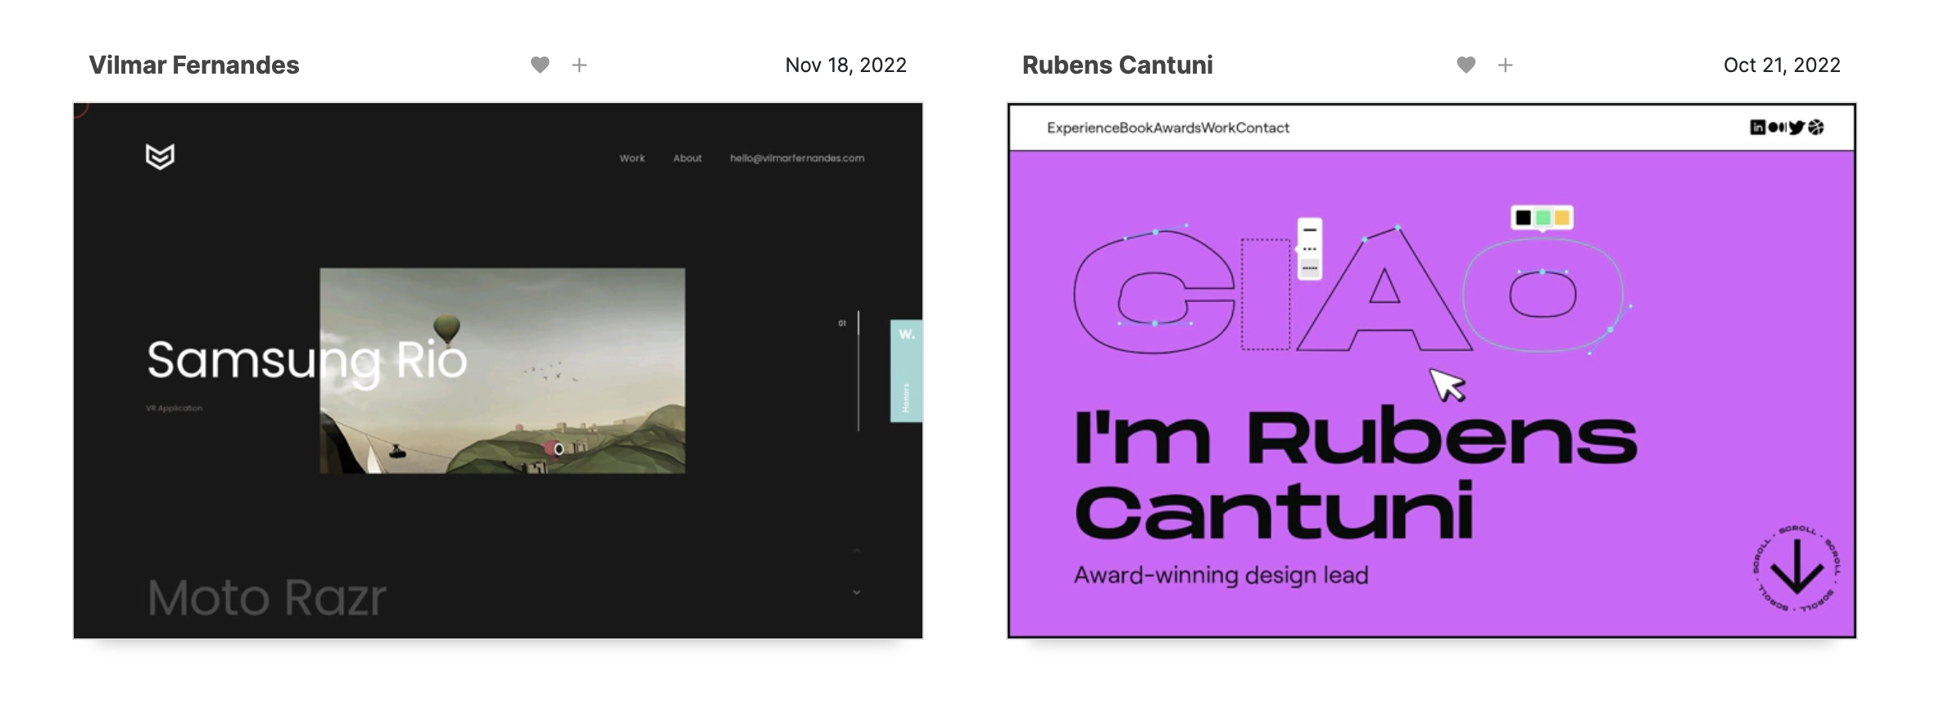
Inspiration
Natural navigation options
Visual appeal
Colours
Font
Interactive elements
https://www.webdesign-inspiration.com/web-designs/type/portfolio
Notes:
Mobile navigation options. I could not do the scrolling webpage or an option that requires JavaScript, but I was determined to place a menu button as an option for mobile.

Slide 6
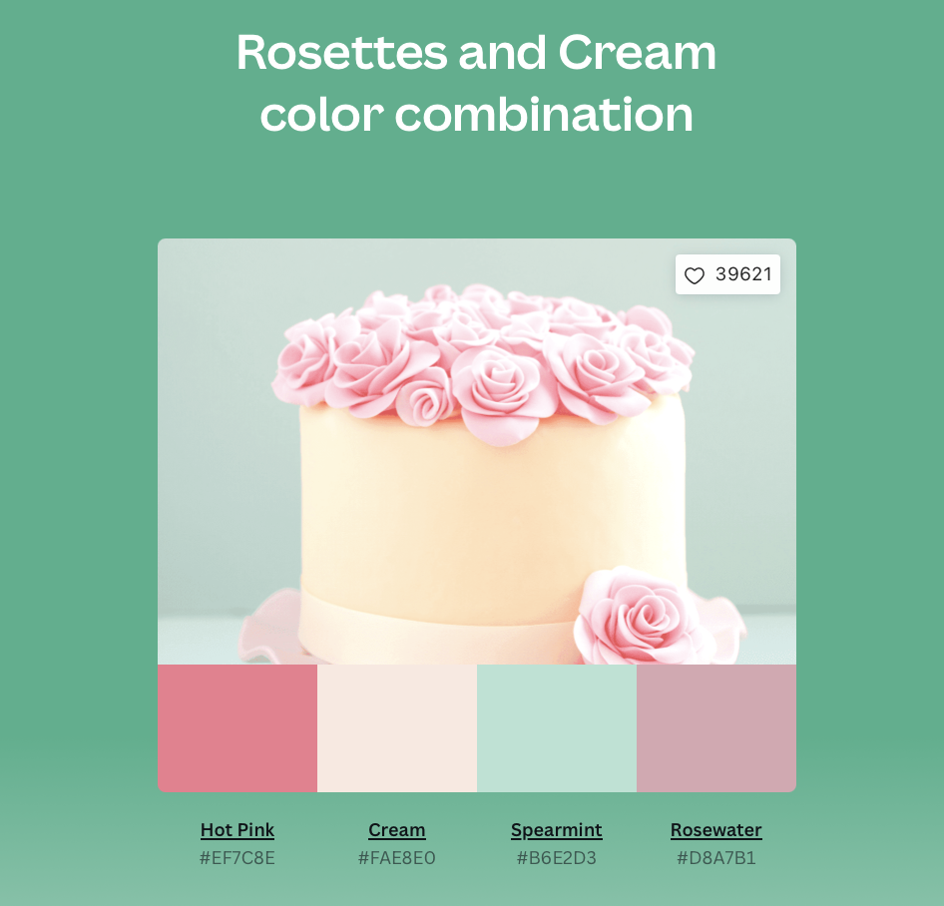
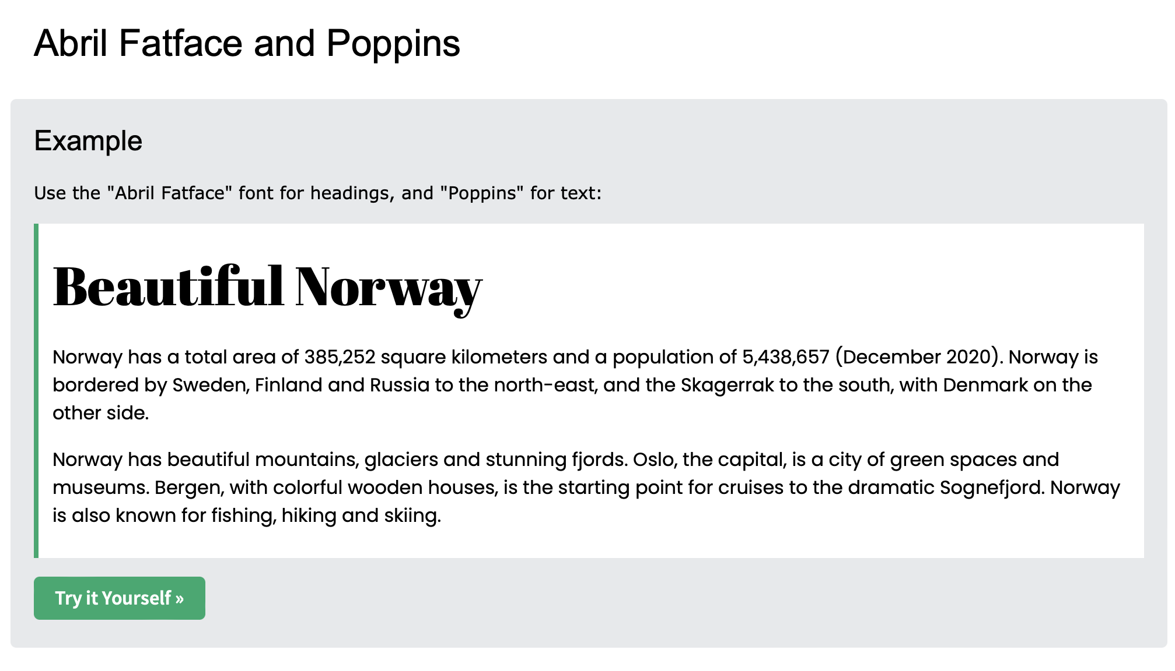
Colour Palette & Font
Contrast ie. Less eye strain
Colour contrast checked on https://webaim.org/resources/contrastchecker/
https://www.canva.com/colors/color-palettes/rosettes-and-cream/
https://www.w3schools.com/Css/css_font_pairings.asp
Notes:
I thought I was good at picking colour combinations, but I took advice from the Edstem course and took a look at Canva.

Slide 7
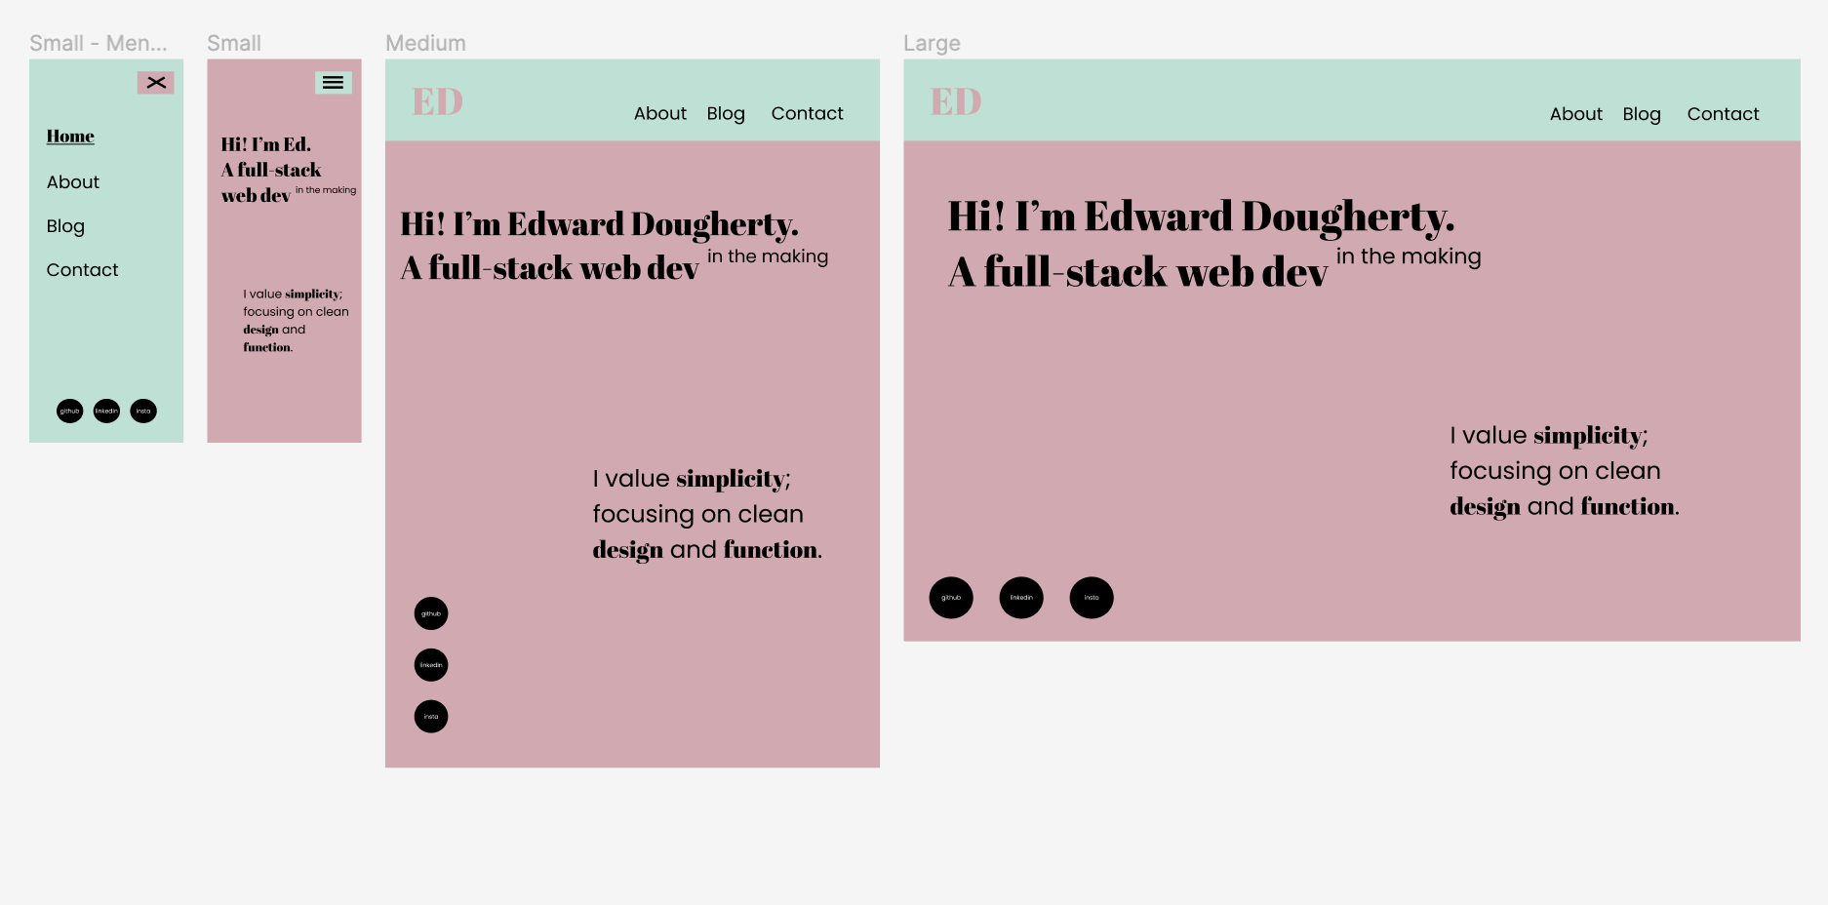
Wireframe
The original design differed slightly from my end product. I am quite happy with the changes I made:
My display picture
Aligning Large view for wide screens.

Slide 8
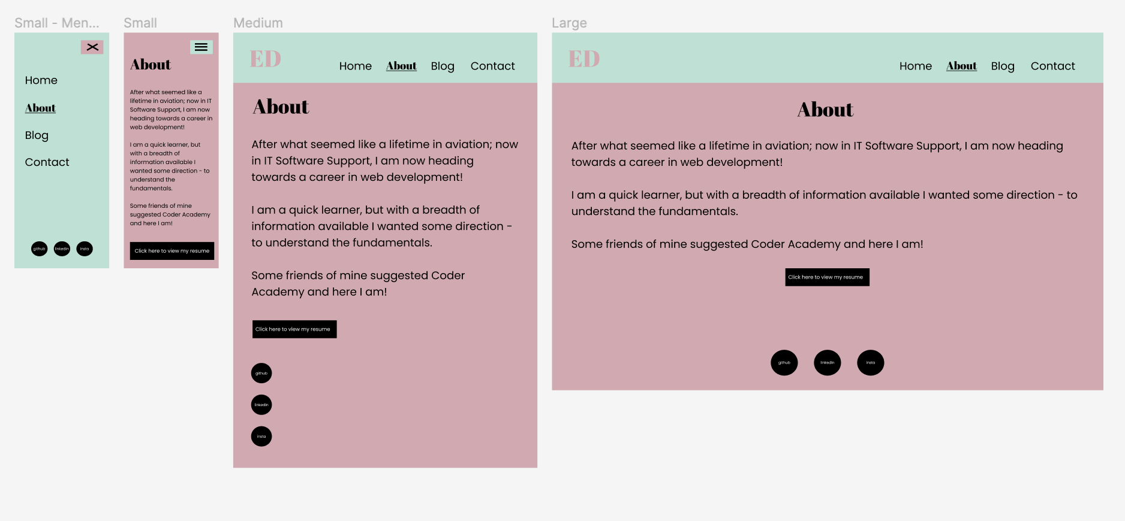
Wireframe

Slide 9
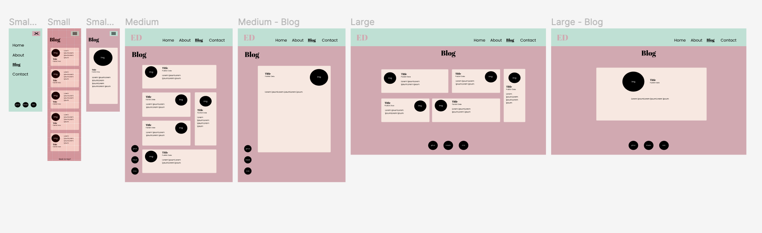
Wireframe
The end product is quite similar, the only option I decided to change was the blog entry for desktop (far right). This was to make it more readable for wide screens.

Slide 10
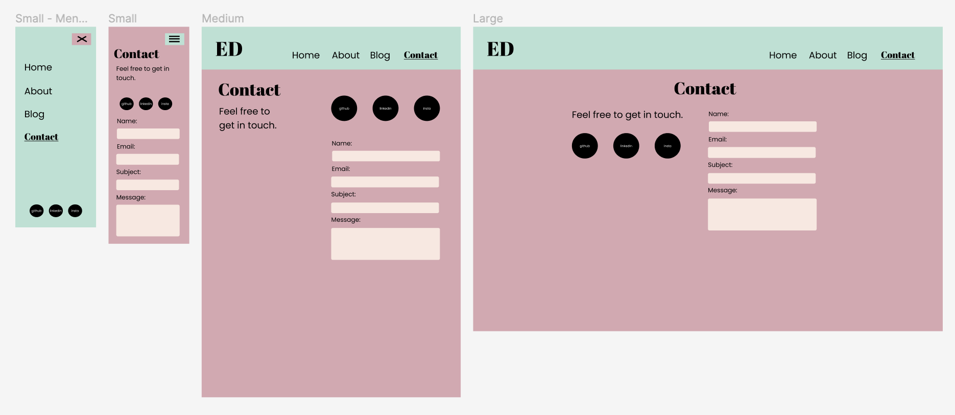
Wireframe
I had chosen to move some text around for ease of coding. I did not want every element to be using an absolute position, the end product uses flex box instead.

Slide 11
Website Build Process
Folder and file structure
Default colours, fonts, and viewport sizes as partial scss files.
Mobile first approach.
Media queries were used after all mobile pages were completed
Once completed debugging and animations were added

Slide 12
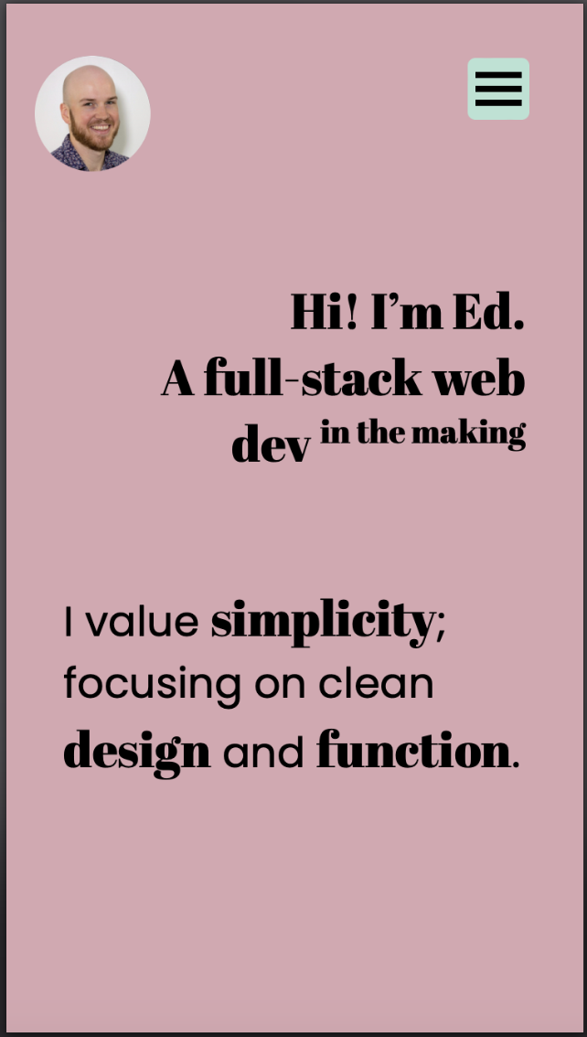
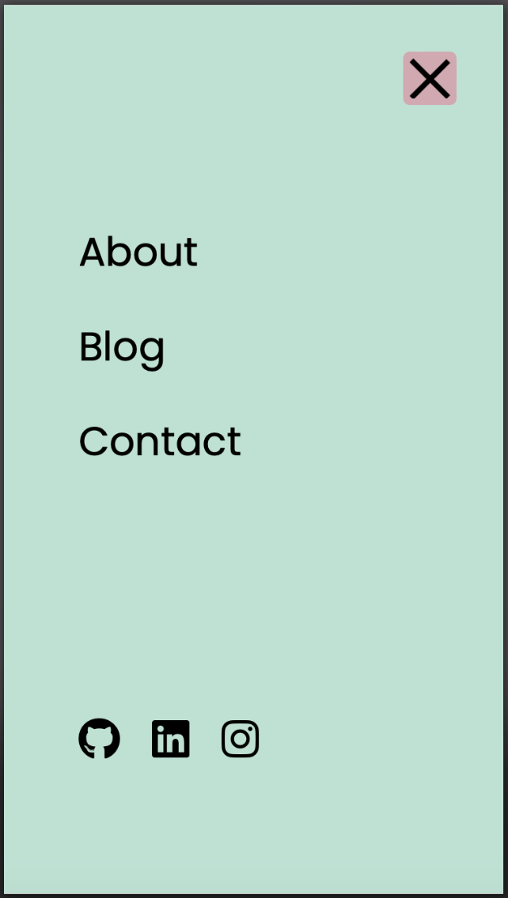
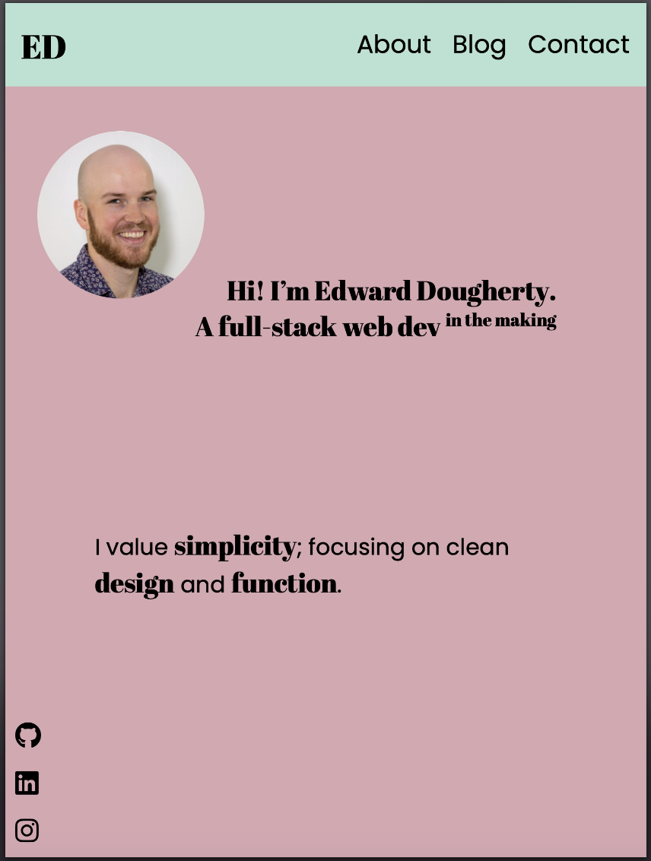
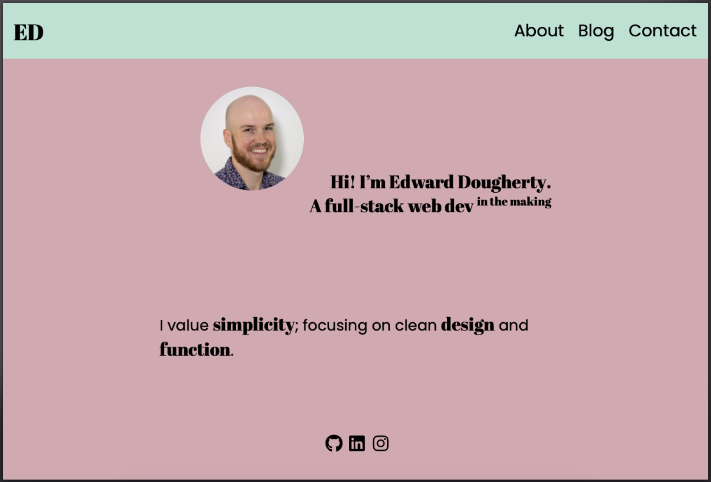
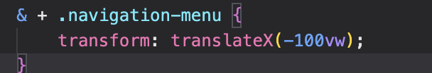
Home Page
Hover elements for each page as a way of interactivity.
Hamburger menu using a checkbox with menu overlay.
Visible header
On click, the menu is moved left using translate
Scalable elements using font size rem and width clamps on elements
Challenges:
Menu button
Header
Social media icons

Slide 13

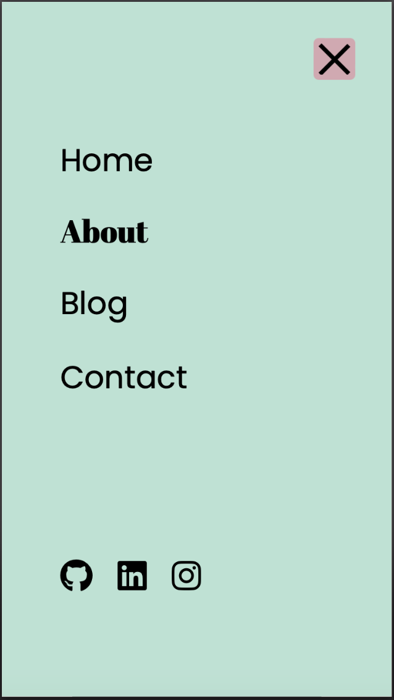
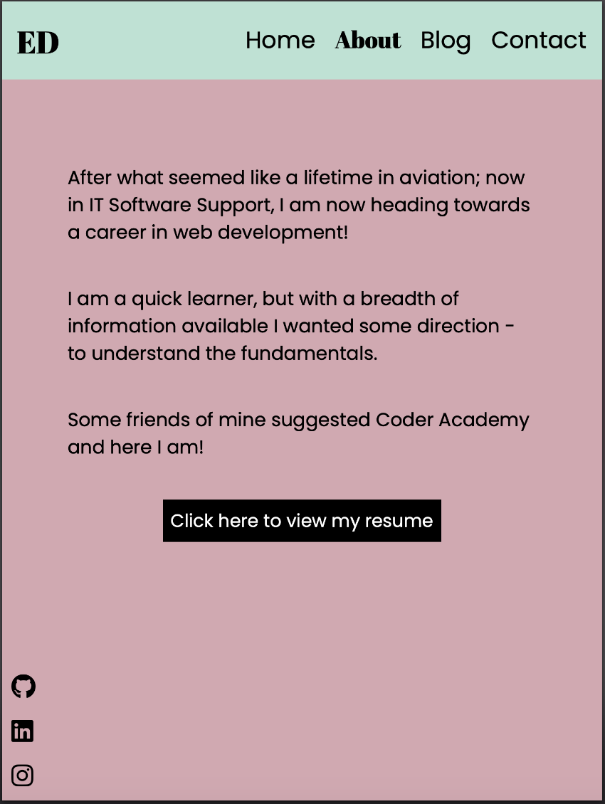
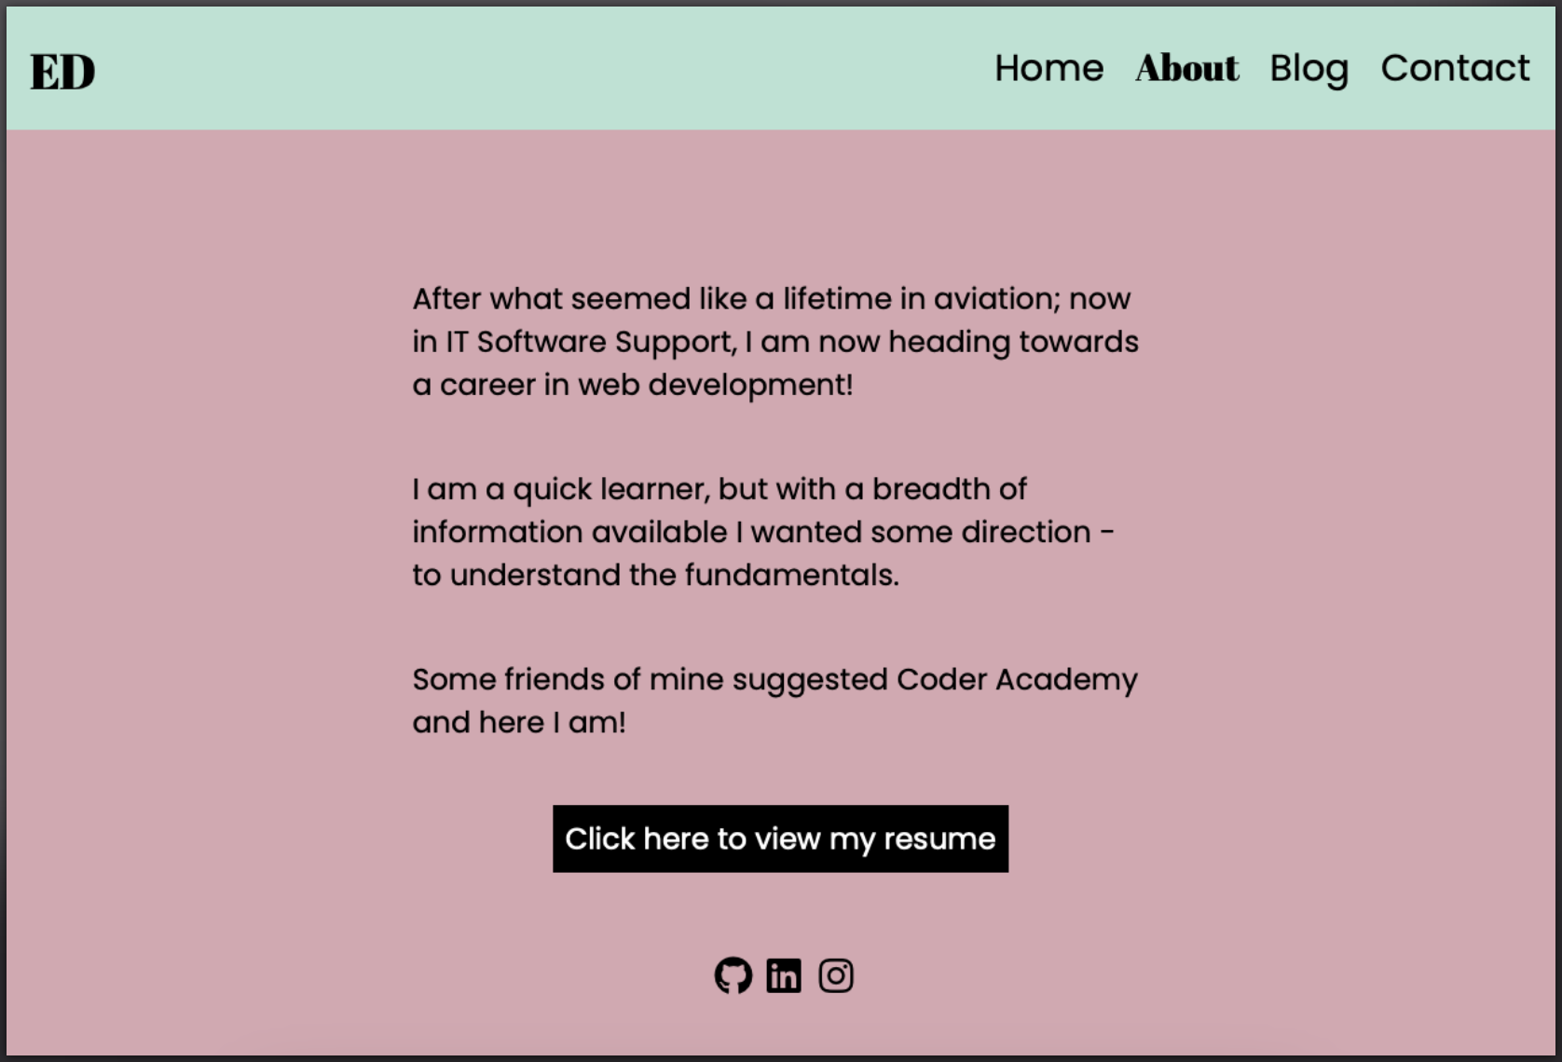
About Page
Heading shows users which page they are on, as well as allows users to go home.
Changed font shows users which page they are on
Simple animations on page load
Challenges:
Correct margins for views

Slide 14
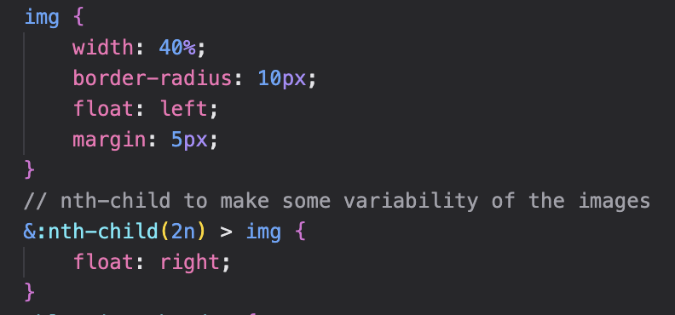
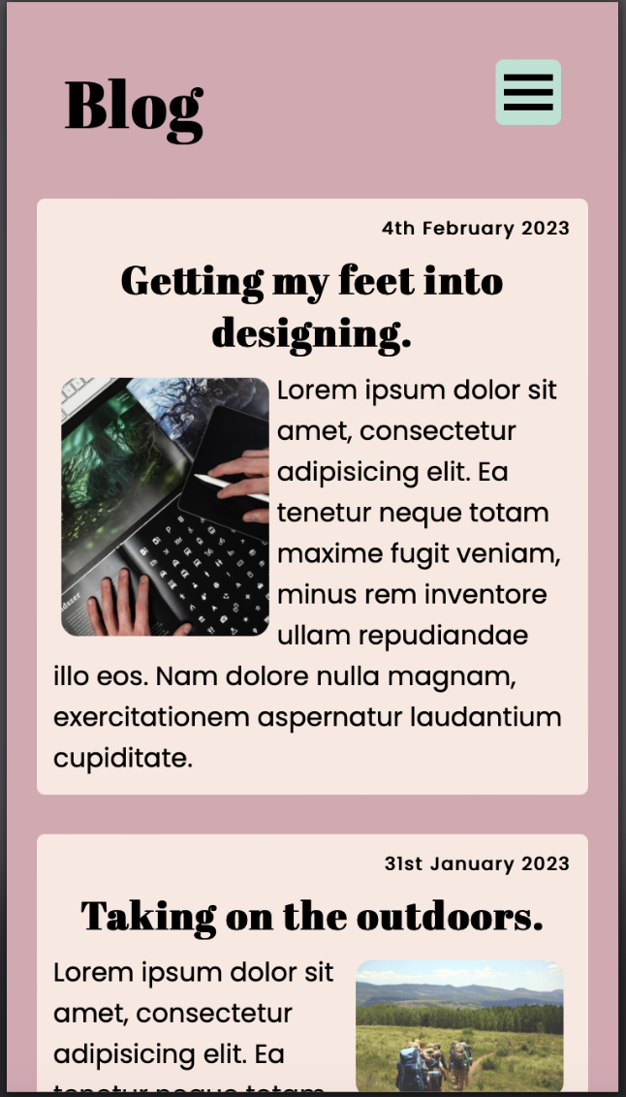
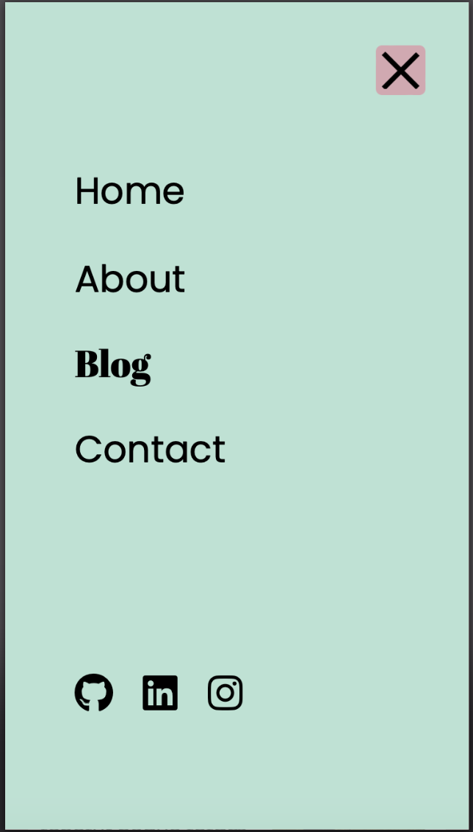
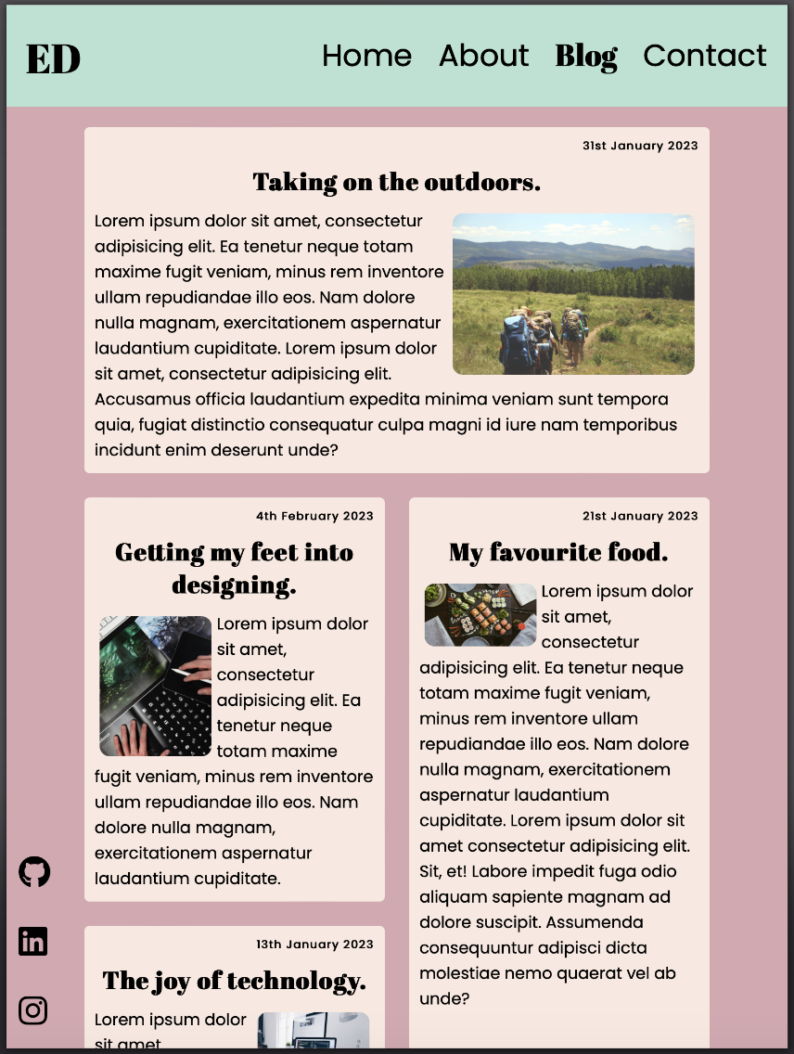
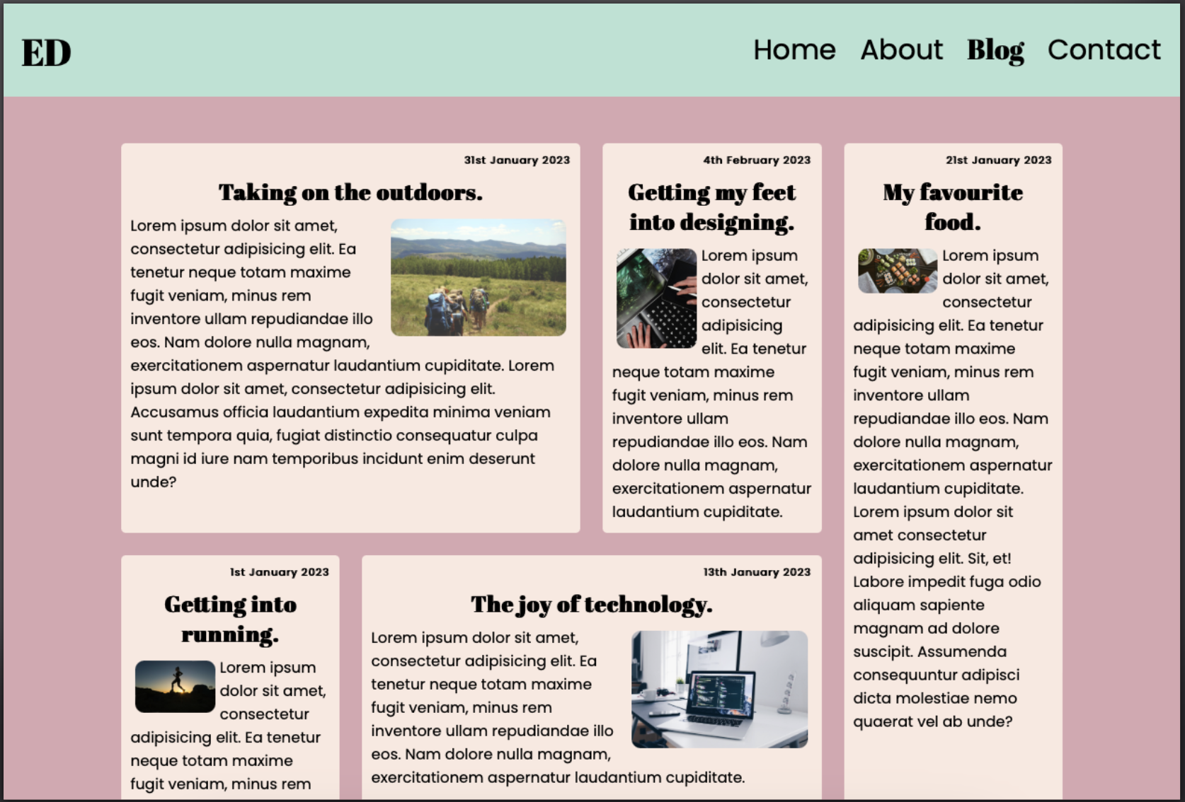
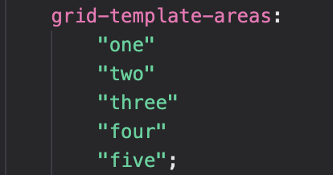
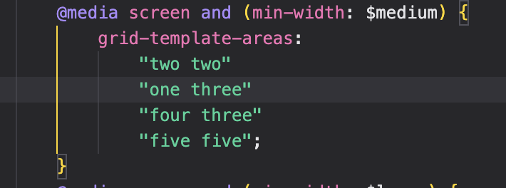
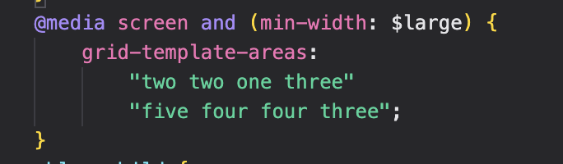
Blog Page
Challenges:
Different images orientation were hard to keep at a scalable size while keeping their original aspect ratio.
Float right for images on even article numbers
CSS Grid changes with media breakpoints

Slide 15
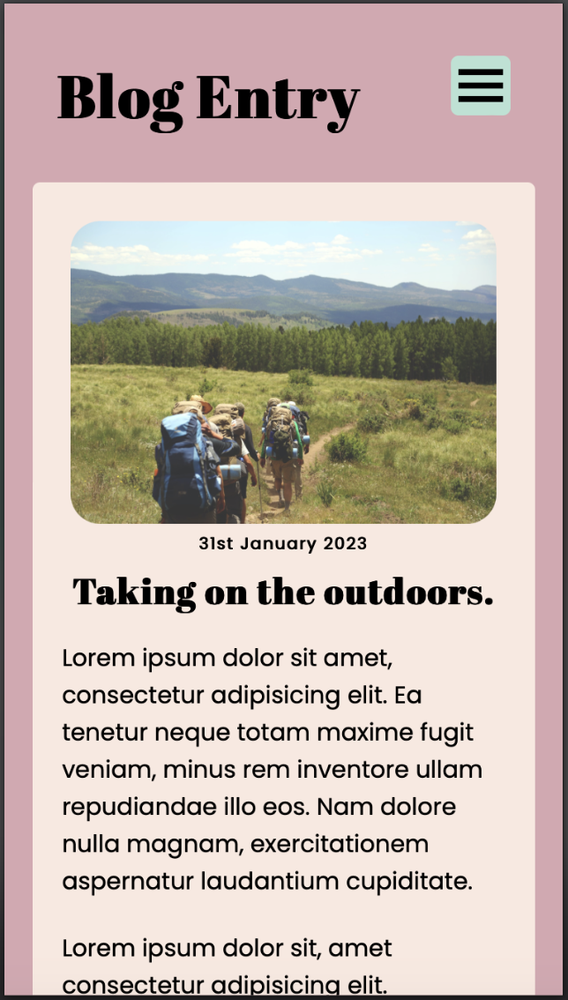
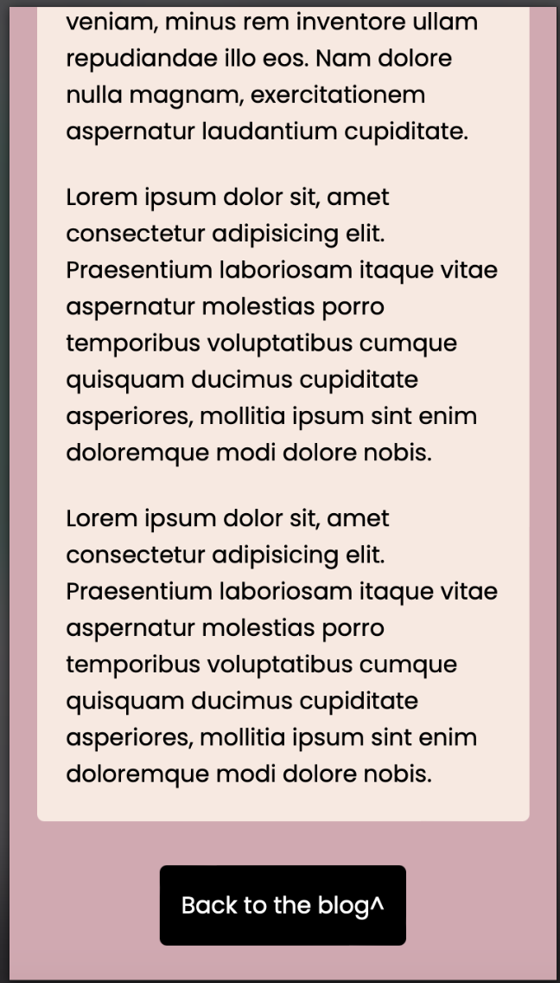
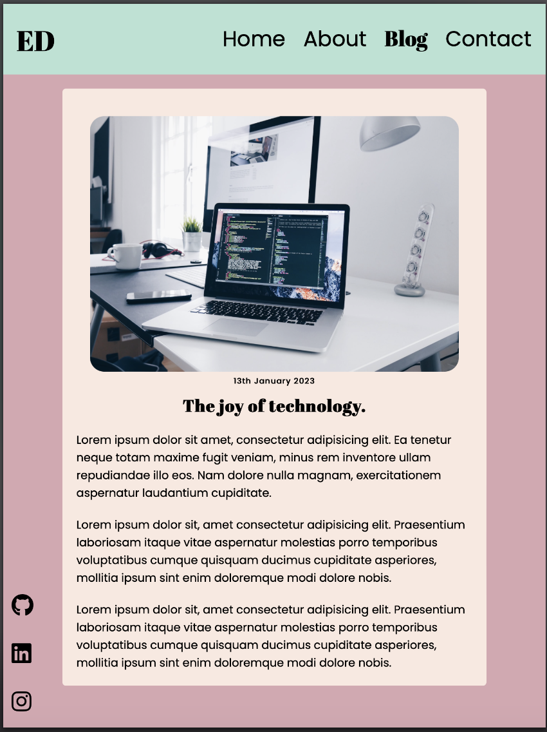
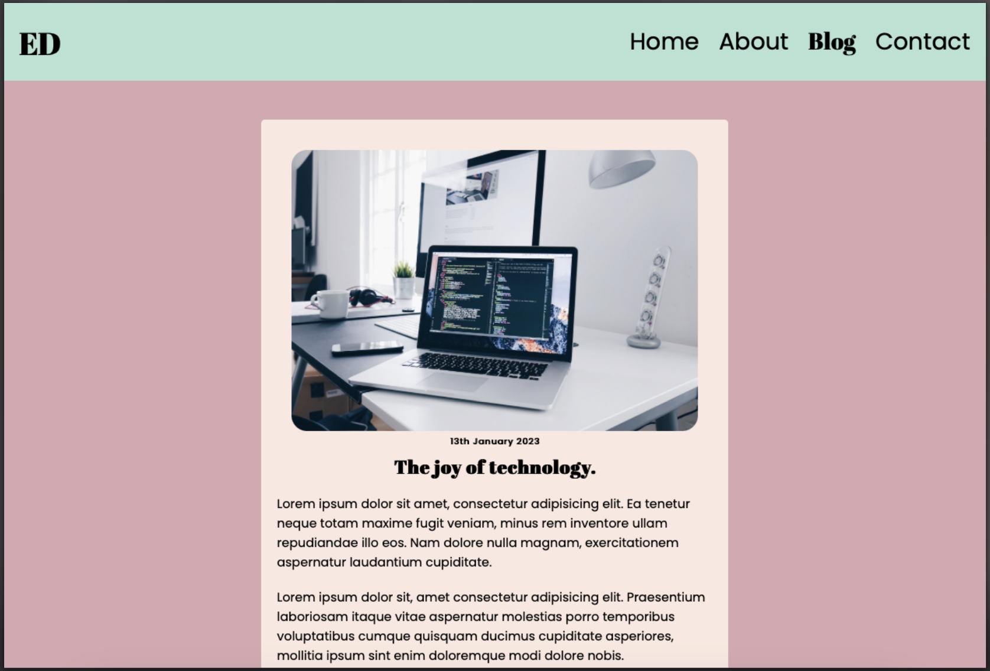
Blog ENTRY Page
‘Back to blog’ button for mobile
Challenges:
Specificity became an issue using one blog.css file for the main page and entries

Slide 16
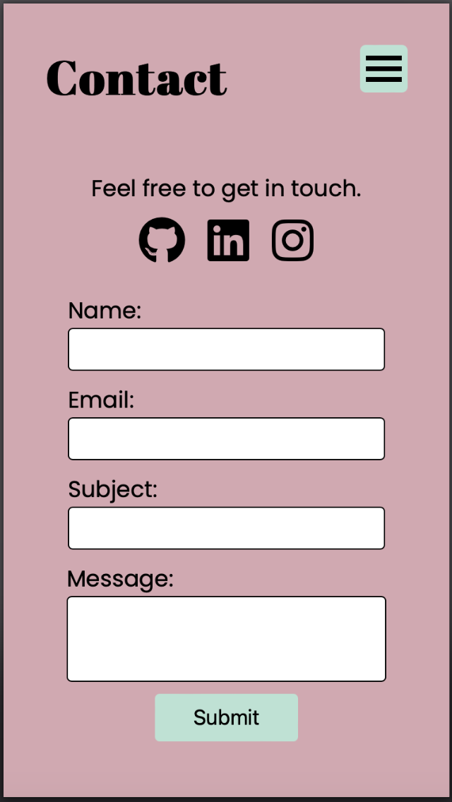
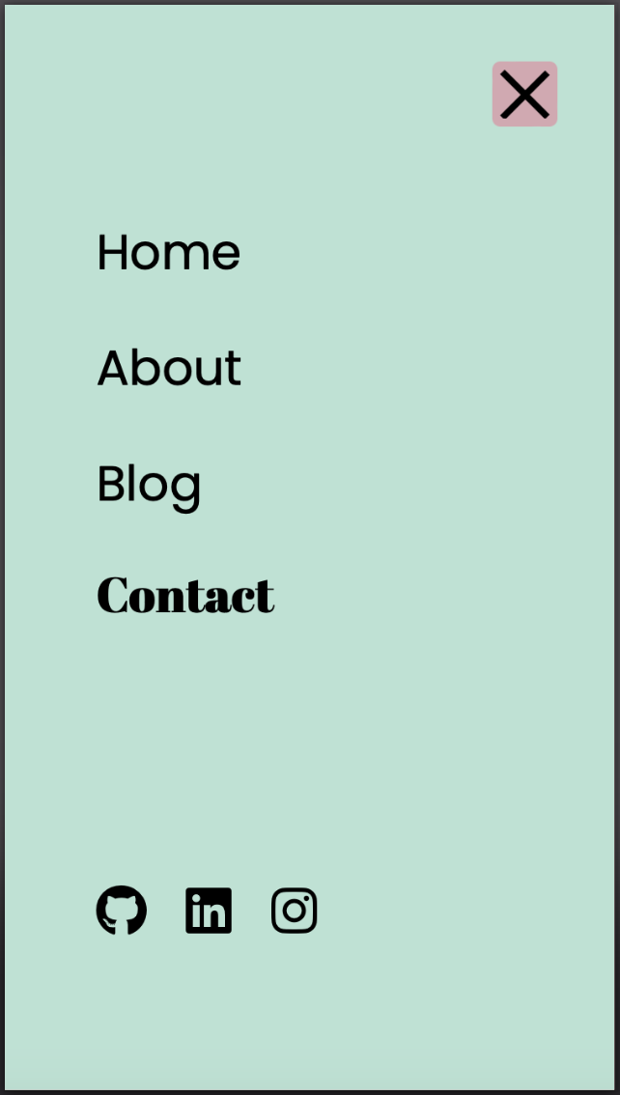
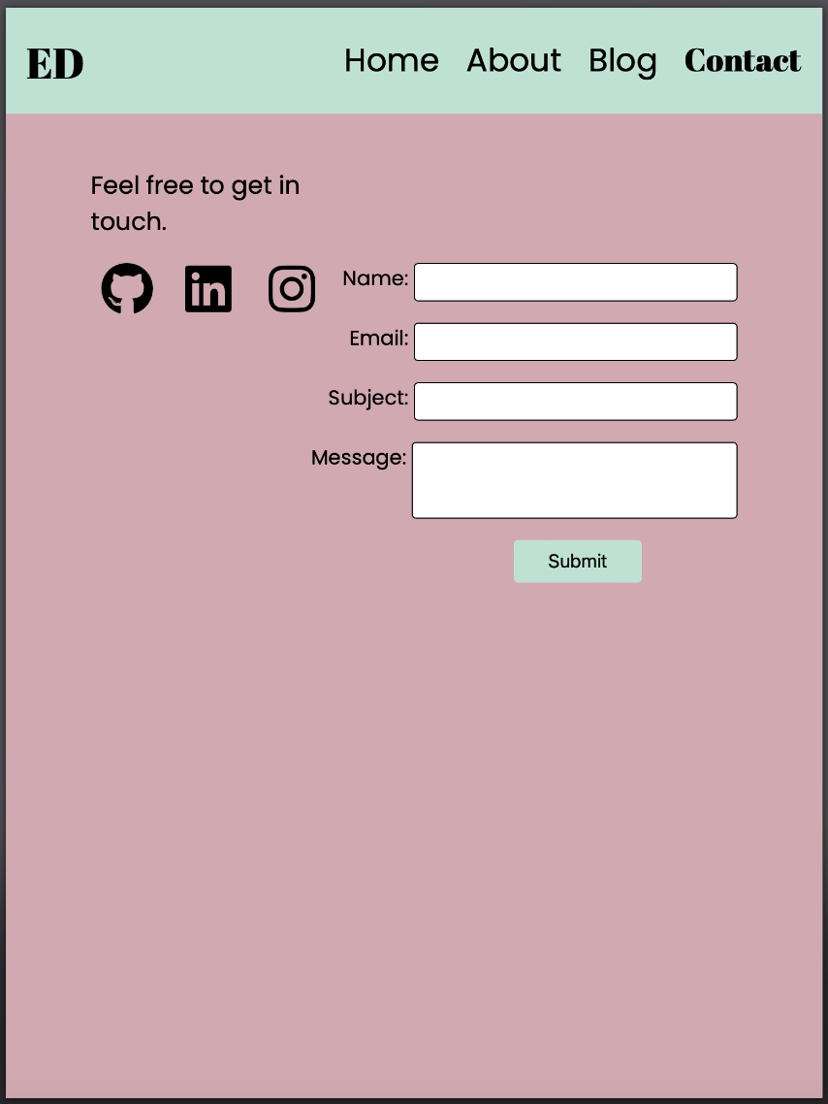
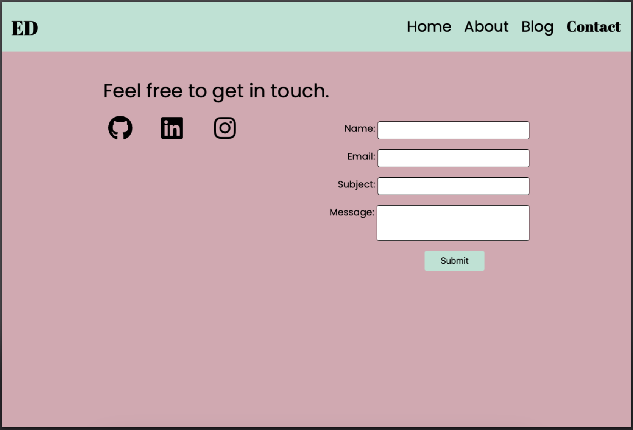
Blog ENTRY Page
Social media icons accessible
Challenges:
Using flex was hard to get the right positioning I wanted for the body

Slide 17
Build Process
Ethical issues
Gaining inspiration and finding out how to make the hamburger menu
Favourite parts
Hamburger menu
Animations
Blog made with CSS grid
Debugging the specificity issues
What I would do differently
Change the way I coded the header and social media icons
Not made the SCSS so specific for the mobile view. Left little room for me to add media queries in with specificity.

